Slide 1

Forecasting hit and runs
Ryan Solava

Slide 2
30%
Percentage of crashes that were hit and runs
515
Serious injuries due to hit and runs in 2021

Slide 3

Data
All crashes from 2017-2021 in Chicago
Features:
Time
Location (longitude and latitude)
Weather condition
Lighting
Damage, injuries, and similar
Additionally
Neighborhood locations
Neighborhood median income

Slide 4

The Idea
Use data to build classifier models
Give model a context to predict how likely a hit and run is
Use these scores to help determine where to send additional resources
A hit and run forecast

Slide 5
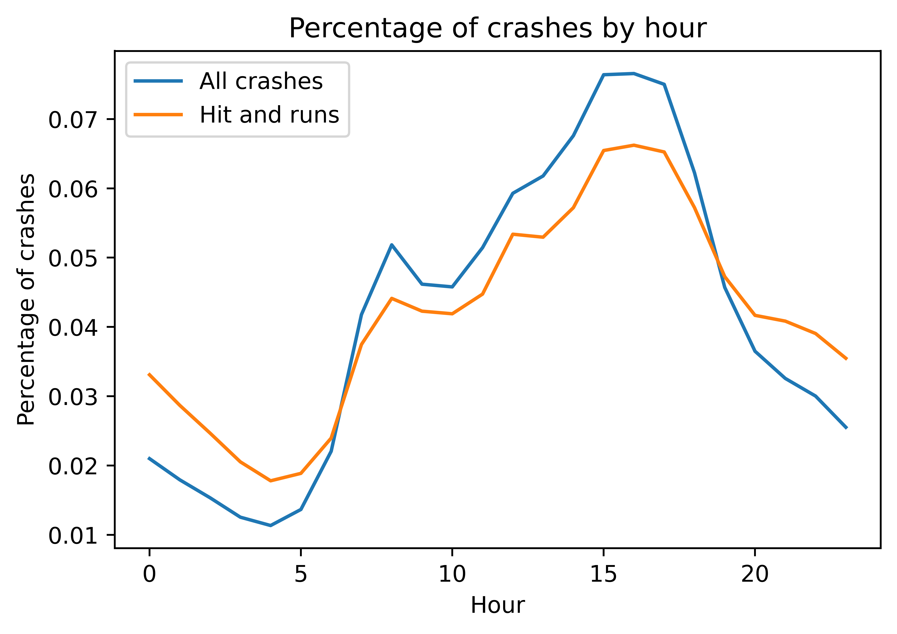
Observations
Hit and runs are more likely when visibility is low

Slide 6
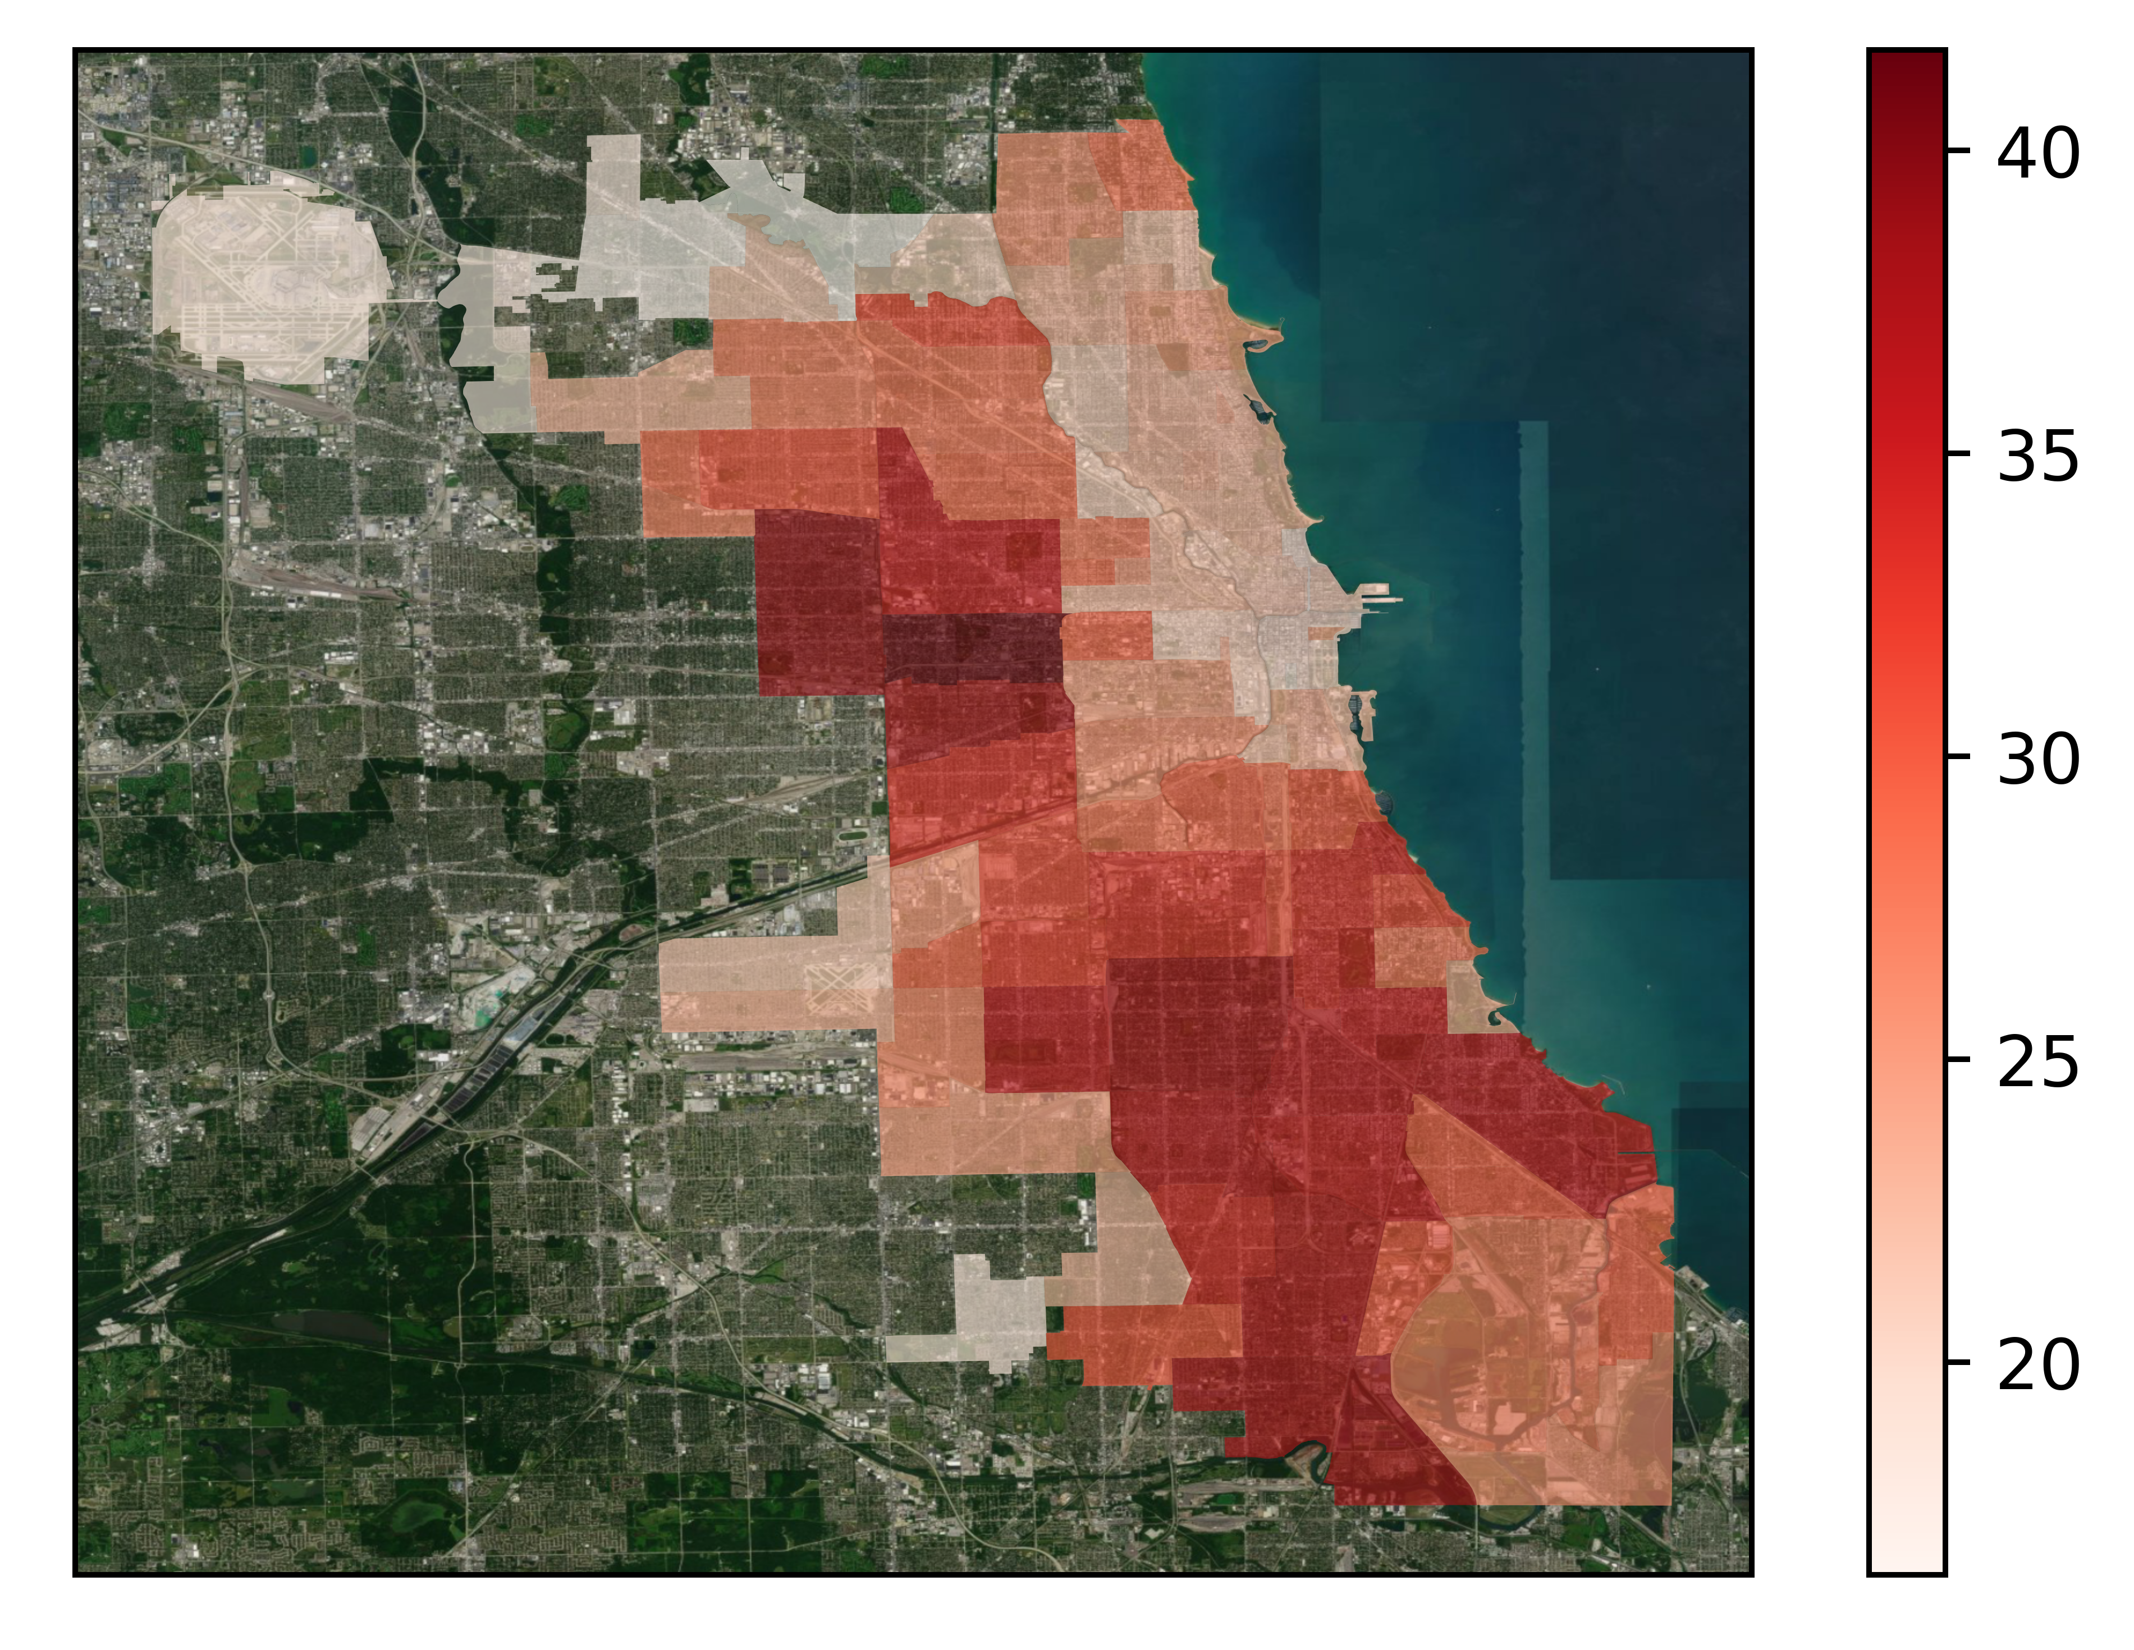
Observations
Hit and runs are more likely when visibility is low
Location matters

Slide 7
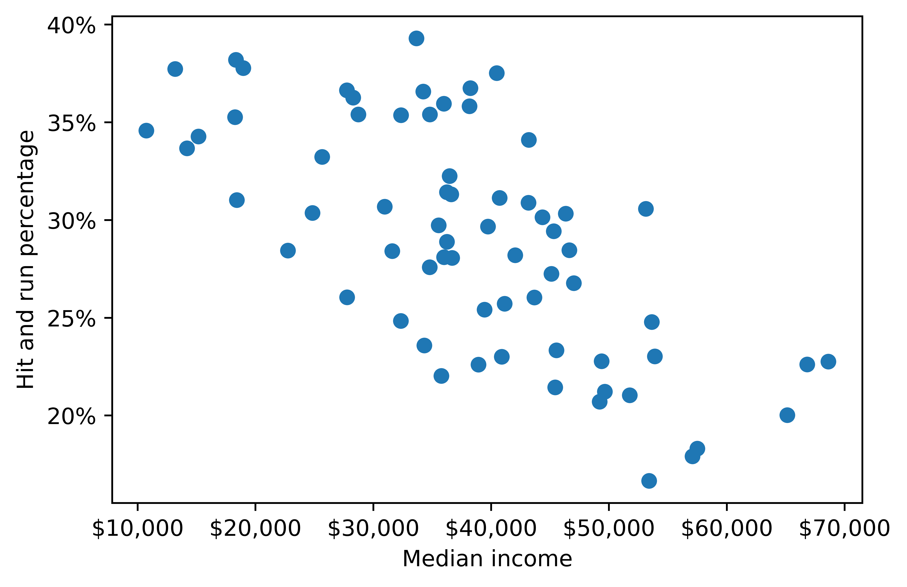
Observations
Hit and runs are more likely when visibility is low
Location matters
Financial component

Slide 8
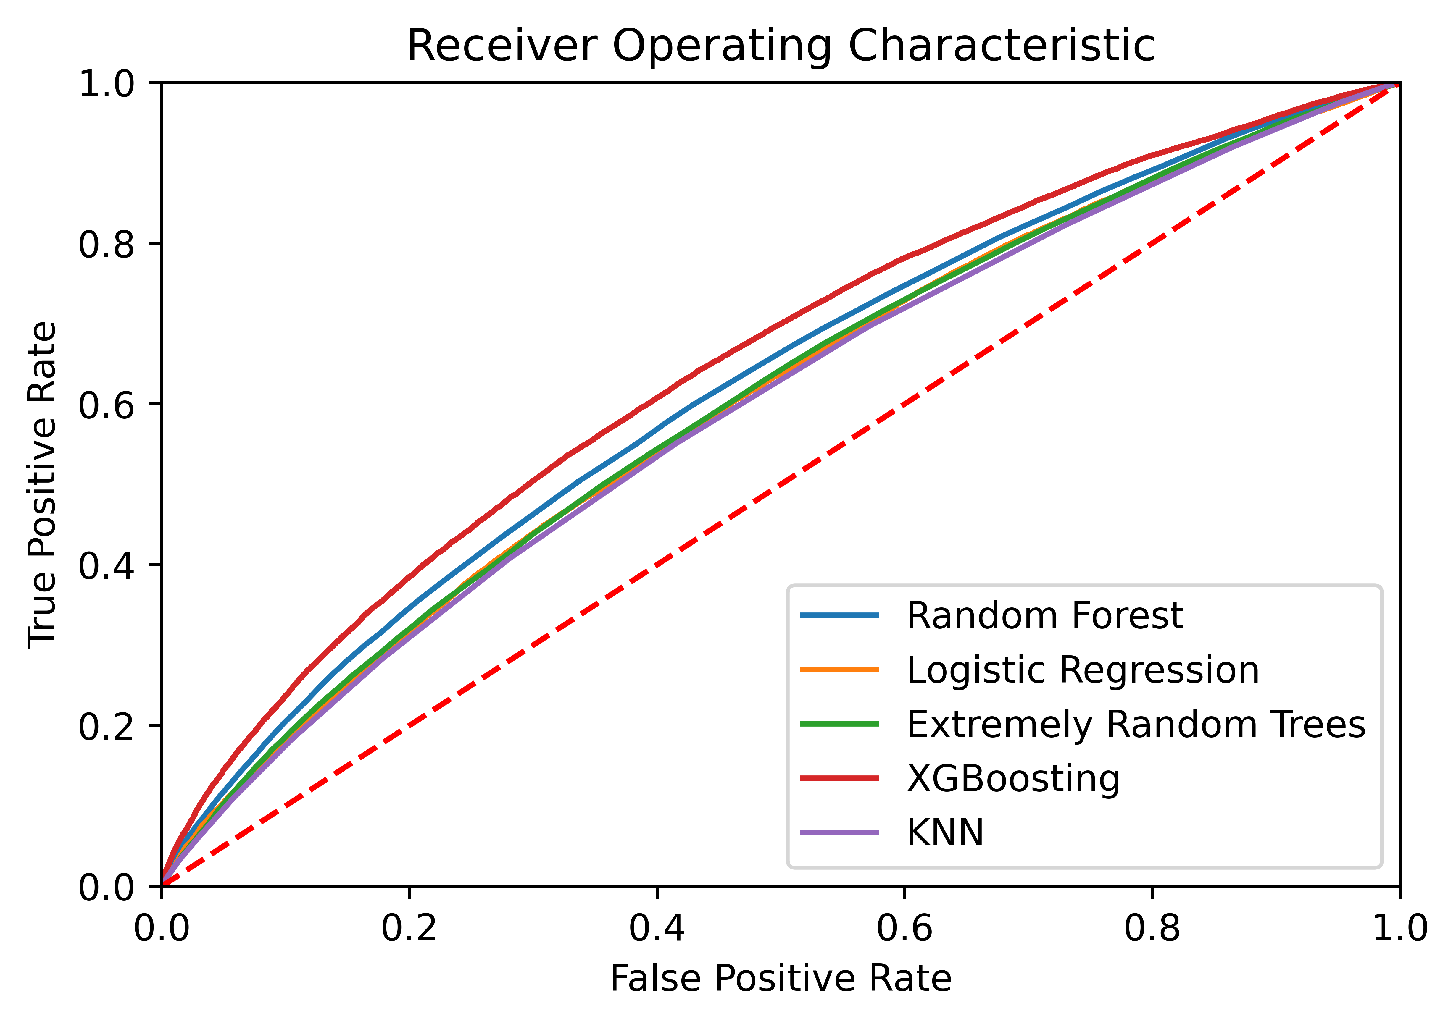
Models
Soft predictors
Naïve Bayes not a good fit
XGBoost performed best
After hyperparameter tuning, achieved an AUC of .655

Slide 9

Conclusions
Location, visibility are main factors
Our model has some predictive strength
Complicated, nuanced, serious problem
Reporting bias in the data
Models don’t give a clear solution

Slide 10
Thank you!

